Slide 1

Summer Bootcamp
Lesson 2: React Basics

Slide 2
Course Schedule
Week 1: Getting started and JavaScript/TypeScript basics
Week 2: React basics
Week 3: Creating our first NextJS project
Week 4: Common patterns and tools used at Hack4Impact
Week 5: Tips and tricks

Slide 3
Why do we need React?
Let’s take a look at some examples written in plain JS…

Slide 4
Why do we need React?
Let’s take a look at some examples written in plain JS…
It can get pretty complicated! Now imagine trying to create something like YouTube with vanilla JS…

Slide 5
Why do we need React?
Hard to add complex HTML to the page

Slide 6
Why do we need React?
Hard to add complex HTML to the page
Data we store doesn’t necessarily correspond to what’s on the page

Slide 7
Why do we need React?
Hard to add complex HTML to the page
Data we store doesn’t necessarily correspond to what’s on the page
Anything else?

Slide 8
Let’s try React!
Let’s look at the basic app written in React

Slide 9
tsx?
.tsx files basically allow us to create functions that return HTML to be rendered on the page

Slide 10
React Concept 1: Data
The first (and arguably most important) feature of React is the ability to bind data (AKA state) to what is displayed on the page using what’s called Reactivity. (Get it?)

Slide 11
Why do we need React?
Hard to add complex HTML to the page
Data we store doesn’t necessarily correspond to what’s on the page

Slide 12
React Concept 2: Components
Components are the reusable building blocks of a React application.

Slide 13
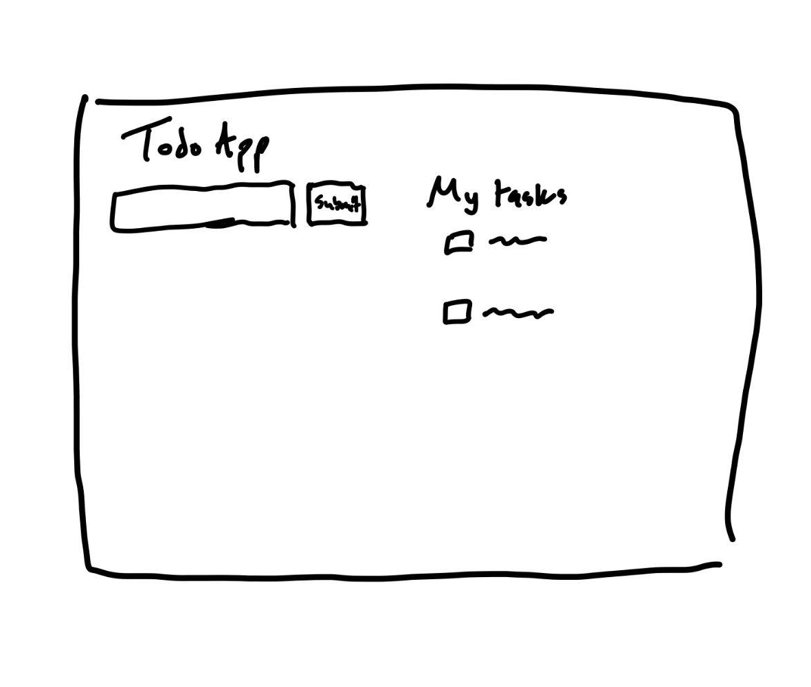

Slide 14
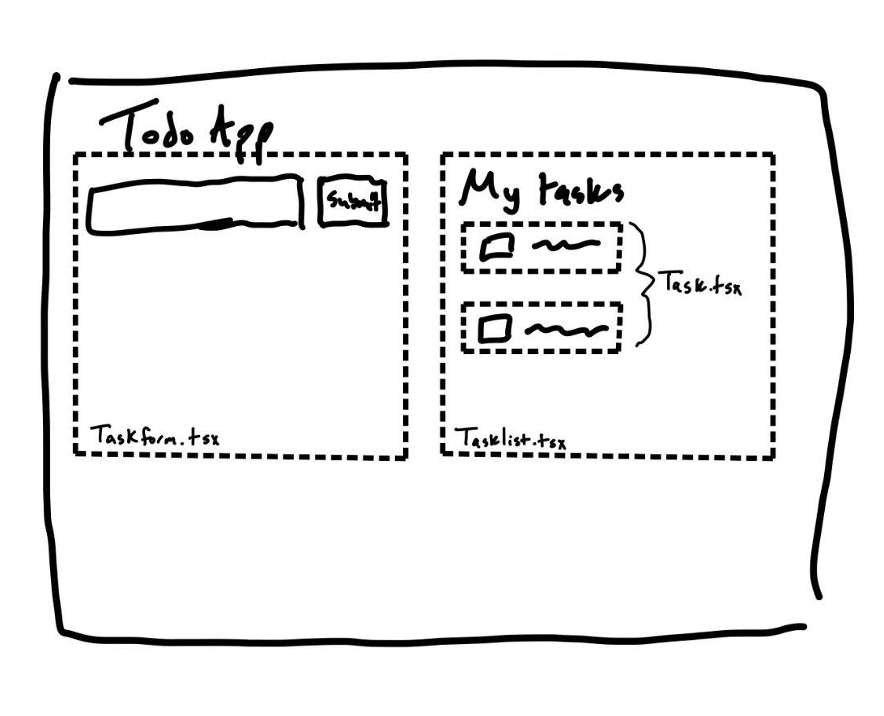

Slide 15
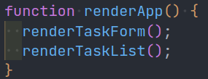
Kinda like functions!

Slide 16
React Concept 3: Props
Sometimes, especially when we use components, we’ll need to pass data down from the parent to a child. What does this mean?
Let’s take a look

Slide 17
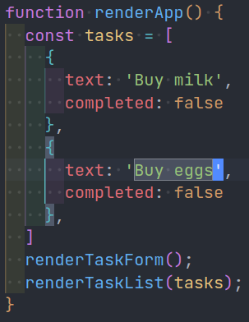
Code Example

Slide 18
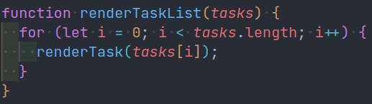

Slide 19
Let’s look at the task list component

Slide 20
Let’s build the task component!!

Slide 21
Points to remember!
tsx files let us write HTML in TypeScript
{} in the HTML will be run as TypeScript
Props to components are passed like HTML attributes
useState is where all the magic happens!
READ THE REACT DOCS TO REALLY GET GOOD!!!!
react.dev/learn

